Slide 1
Smartphone Programing

Slide 2
Syllabus
Introduction to smartphone
Smartphone hardware components
Mobile operating systems
Smartphone programming

Slide 3
Introduction to smartphone

Slide 4
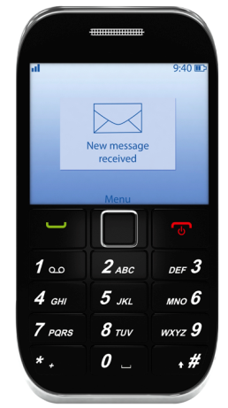
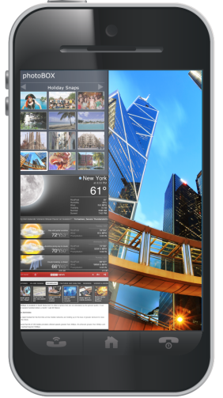
Introduction to Smartphone
Early phone
Basic functions, e.g. make and receive telephone calls
Basic components, including battery, keyboard, SIM card etc.
A smartphone
More advanced computing capability
More connectivity
More features like touchscreen, running apps, web browsing, Wi-Fi etc.
Can run operating systems such as Android, iOS, Windows, Palm OS, Symbian

Slide 5
Introduction to Smartphone
A smartphone’s hardware typically consist of
Display and touch screen
Camera
Battery
Antenna
Main PCB
Application processor chip
Memory chips
RF transceivers chip
Power management chip
Others such as GPS, SIM, video processing, Bluetooth

Slide 6
Smartphone hardware components

Slide 7
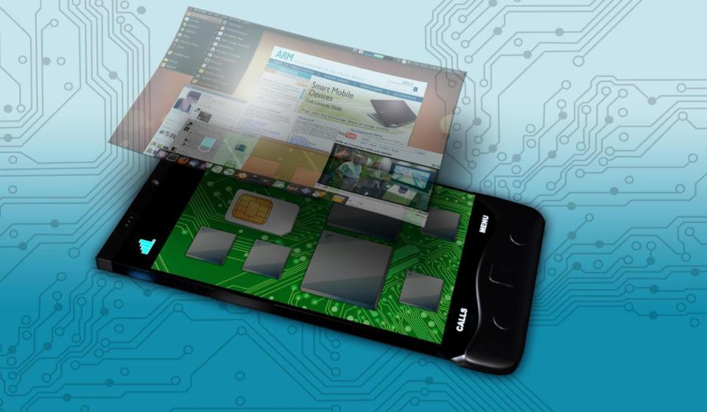
Smartphone Hardware Components
Bluetooth
WiFi
It’s Not Just the Apps Processor
Cellular Modem
SIM
Memory Chip
GPS
Apps Processor
Power Management
Touchscreen Controller

Slide 8
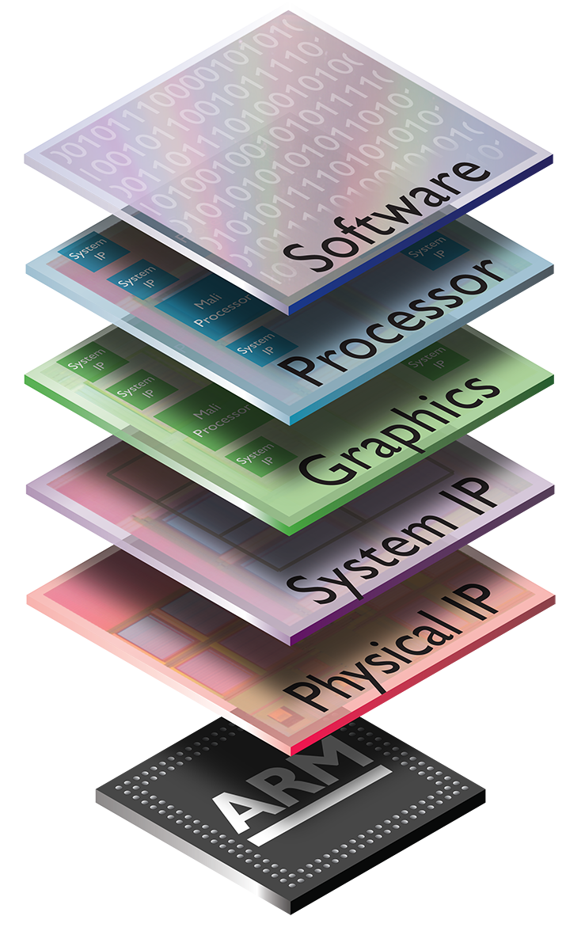
ARM at the Heart of your Smartphone
ARM
Designs IPs, such as processor IPs, physical IPs, System IPs, GPU IPs
Licenses IPs to silicon partners, such as Qualcomm, Samsung, Apple, NVIDIA
Also provide software supports to silicon partners and application developers
Is a business to business company that does not manufacture large number of chips or end products
Silicon partners
Select a set of IP cores from ARM or other third-party IP vendors
Integrate IP cores into a single chip design
Give design to semiconductor foundries for chip fabrication

Slide 9
ARM at the Heart of your Smartphone
Bluetooth Cortex™-M3 & Cortex-M0
WiFi Cortex-R4 & ARM968™
It’s Not Just the Apps Processor
Cellular Modem Cortex-R4, Cortex-R5 &
Cortex- R7
SIM Securcore® SC300™
Memory Controller Cortex-M3
GPS Cortex-M3 & Cortex-M0
Apps Processor
Cortex-A5 (MPCore), Cortex-A9 (MPCore)
Cortex-A15 (MPCore);
Cortex-M4
ARM Mali™ Graphics
Power Management Cortex-M3 & Cortex-M0
PLUS
CoreLink™ System IP
Artisan® Physical IP 65-28nm
Development tools
Touchscreen Controller Cortex-M0

Slide 10
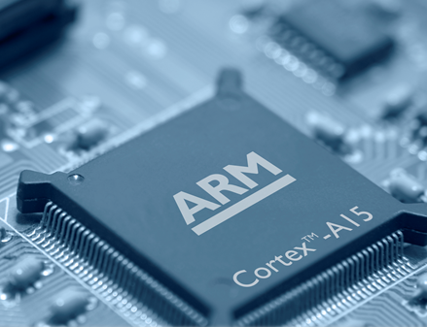
Smartphone Hardware Components
Mobile application processor
Is a System-on-Chip (SoC) that supports running applications in a mobile operating system
Most of them are based on ARM Cortex-A processors since they deliver high performance with less power consumption, e.g. Cortex-A5, Cortex-A9, Cortex-A15
Examples include SnapdragonTM by Qualcomm®, Tegra® by Nvidia®, Ax by Apple®, OMAPTM by Texas Instruments, etc…
Could also be used in other mobile devices, such as smartphones, tablets and digital cameras

Slide 11
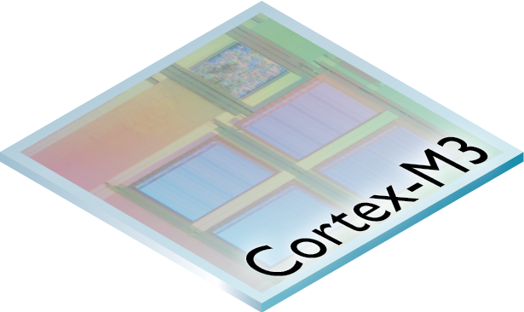
Smartphone Hardware Components
Memory chip
Used for large data storage
Managed by a memory controller - a piece of hardware that is mainly used for controlling the data flow going to/ from the memory block
Memory controller
Facilitate the access to the heterogeneous physical devices, e.g. SRAM, DRAM, FLASH, hard disk etc.
Supporting a variety of memory access modes, such as burst mode, memory paging, etc…
Usually implemented on ARM Cortex-M based microcontrollers, e.g. Cortex-M3

Slide 12
Smartphone Hardware Components
RF chip
Transmits and receives radio frequency for communications such as WiFi, Bluetooth, FM etc.
ARM Cortex-R processors are commonly used as they can deliver real-time performance. For example, Cortex-R4, Cortex-R5, Cortex-R7
Power management chip
Used for managing power requirements of the host system
Supports features such as voltage scaling/ regulating, DC - DC conversion, battery charging, power-source selecting etc.
ARM Cortex-M processors are commonly used as they can provide efficient control with low power consumption, e.g. Cortex-M0, Cortex-M3

Slide 13
Smartphone Hardware Components
GPS receiver
Receives signals from satellites and use it to position itself, with the assist of navigation applications, such as Google map
Could be implemented on Cortex-M3, Cortex-M0
SIM (Subscriber Identity Module)
Stores international mobile subscriber identity (IMSI)
ARM SecureCore processors are enhanced with security features, providing easy development for smart cards and secure ICs
Bluetooth
Bluetooth is quite often used in short distance communications at low power consumption
Most Bluetooth modules can be implemented on ARM Cortex-M0 and Cortex-M3 processors

Slide 14
Mobile Operating System

Slide 15
Mobile Operating Systems
Mobile OS
Can be operated on a smartphone, tablet or other mobile devices
More mobile features compared with OS on PC
Support touchscreen
Support more communications features, e.g. cellular Bluetooth, GPS, near field communication (NFC)
Others like Speech recognition
Consists of a high-level user interface and a low-level kernel for managing hardware in real-time
Most well-known mobile operating systems include Android, iOS, Windows etc.
Notes:
Programming mobile - Appcessory programing, should be categorised as another subject. In this material, we only brief some fundamental app programming based on Android OS

Slide 16

Android Operating System
Developed by Google and Open Handset Alliance
Written in Java (for UI), C (for core) and C++
Based on Linux kernel
Software stack
Application – home, contacts, phone, browser etc.
Application framework – activity manager, window manager, notification manager, contact provider etc.
Libraries – surface manager, media framework, OpenGL, webkit etc.
Linux kernel – display driver, camera driver, Bluetooth driver, flash memory driver, WiFi driver etc.
Applications
Applications
Framework
Libraries
Linux Kernel

Slide 17
Smartphone Programing

Slide 18
Android App Design Flow
Android Software Development Kit
Provides API libraries and developer tools
Supports debugging apps for Android
App development workflow
Setup – install Android SDK and tools, create virtual devices
App development – create a project with source code, e.g. resource files and manifest files
App debug and test – test app using debugger and instrumentation framework
App publish – configure and test code in release mode, publicize, sell and distribute app to users
Environment setup
App development
App Debug and test
App Publish

Slide 19
Application Fundamentals
Creating an Android app
Programed in Java
Compiled using Android SDK tools into an Android package – APK file
APK file contains all the contents to install the app
Running an Android app
Dependency of an app
Android OS is a multi-user based Linux system – each app is an user
Each app has a unique Linux user ID – files in an app can only be accessed by that user ID
Each process has its own virtual machine – apps run independently
Process of an app
Starts when any of the app’s components need to be executed
Shuts down when it’s no longer needed or memory is required for other apps

Slide 20
Application Fundamentals
Principle of least privilege
Each app has the access to only to the components it needs
Apps do not have access to other components without permission
Data and service share between apps
Two apps share a single Linux ID – thus can access to each other
Device data, such as contacts, location, camera, Bluetooth can be shared with the permission from the user

Slide 21
Android App Components
There are four components – activities, services, content providers and broadcast receivers
Activities
Single screen user interface, (UI) e.g. a web browser app can have one activity for one
Independent from each other, thus one can be called from each other at any instance, e.g. Start dialling from a webpage
Work together to form cohesive user experience
For example, in your Email app, you have activities such as inbox, outbox

Slide 22
Android App Components
Services
Can be started by an activity
Does not provide an UI
Runs in the background
For example, wireless service, playing a music at background
Content provider
Provides shared data
Data can be read or modified by other apps, if allowed
Example: Contact book
Can also be used for private data

Slide 23
Android App Components
Broadcast receivers
Broadcast – an announcement to all apps (system-wide)
Broadcast receiver responds to those announcement
Can be from system, such as low battery, or other apps, e.g. a message is received
No UI but uses notification bar
Used for inter-app communication
Minimised interference between apps
Broadcast received and
displayed as a notification
Message app
Game app
(current UI)
broadcast
Message app

Slide 24
Android App Components
When App-a needs a component from App-b
App-a sends a message to the system, the message can be called as an intent
System permits and activates the component for App-a
System starts processing App-b
System initialises the related classes
Component started
When it is completed, the result is returned to App-a

Slide 25
Manifest File
The manifest file
Declares all the components of an app, e.g. activities, services, broadcast receivers and content providers
Declares component capabilities
Declares app requirement, such as
API Level
HW/ SW features, e.g. Bluetooth service
API libraries
Identify user permissions

Slide 26
Example of Manifest File
<manifest xmlns:android="http://schemas.android.com/apk/res/android"
…>
<uses-permission android:name="android.permission.BLUETOOTH" />
<uses-sdk
android:minSdkVersion="8"
android:targetSdkVersion="18" />
<application
.....
<activity
android:name="com.example.test1.MainActivity"
...
<intent-filter>
<action android:name="android.intent.action.MAIN" />
</intent-filter>
</activity>
…..
</application>
</manifest>
Declare user permission
Declare requirement
Declare activity
Declare intent

